Slide 1
OWASP ML Top 10
Null | Hyderabad
Presented by
M S Nishanth

Slide 2


Slide 3
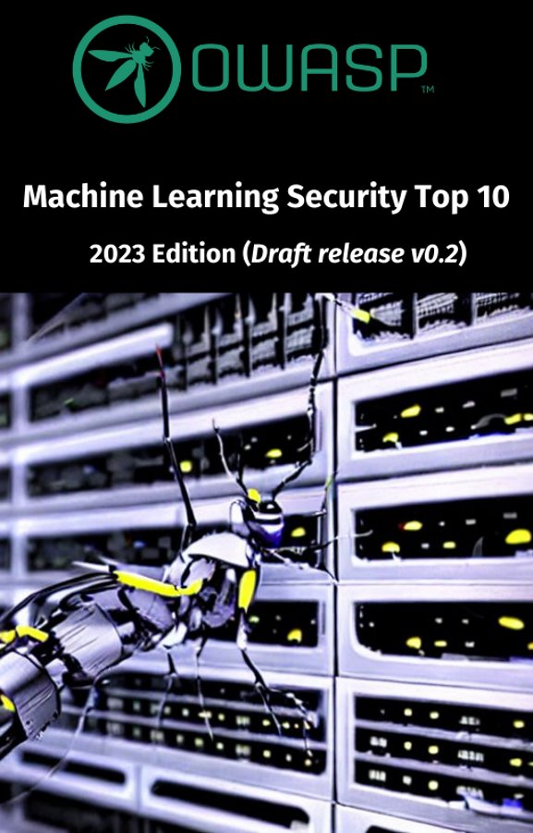
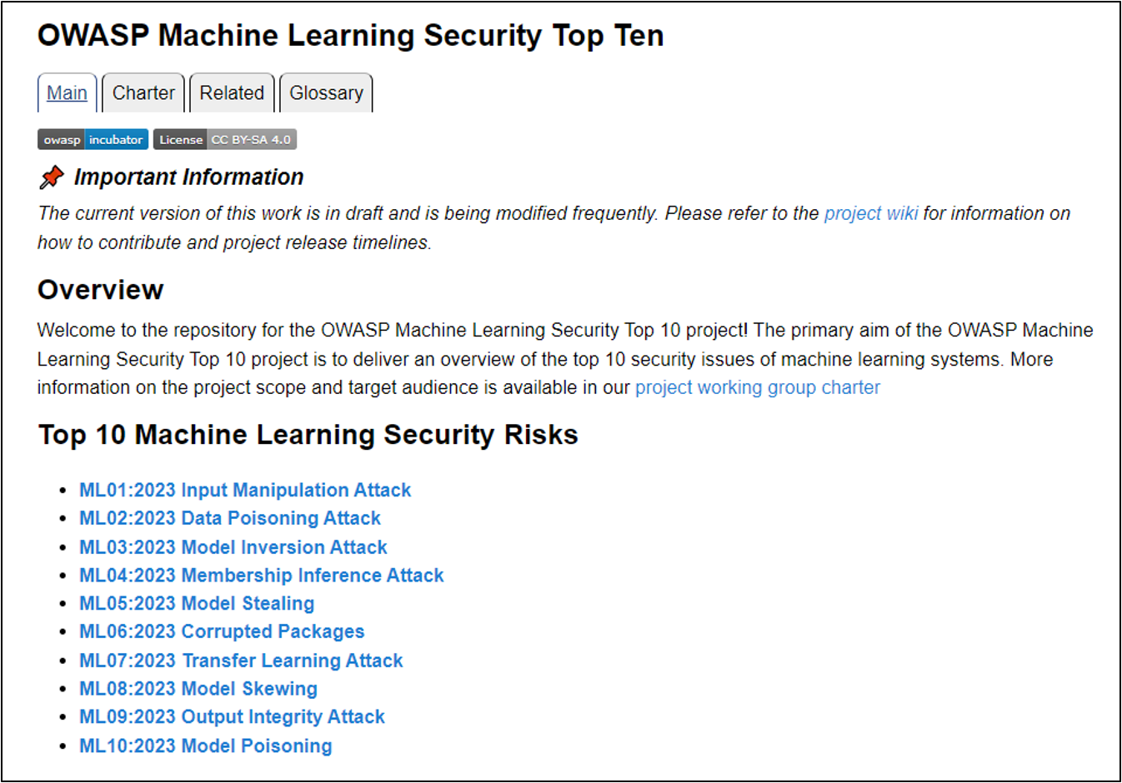
https://mltop10.info

Slide 4

Project leaders

Slide 5


Machine learning

Slide 6
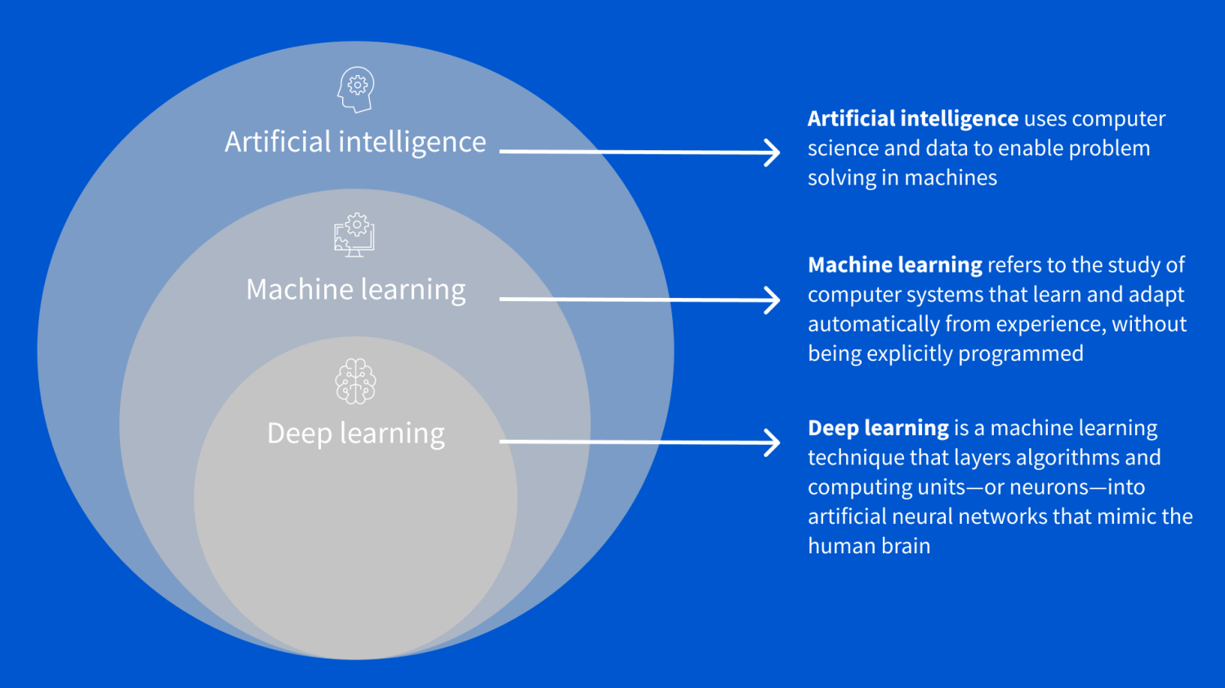
Machine learning

Slide 7
How to ml
Q-learning
Principal Component Analysis
Monte Carlo
Decision tree
LSTM
Graph neural networks (GNNs)
BERT
EfficientNet
GAN
Deep Q-Learning
Recurrent neural network
Convolutional Neural Network
Naive Bayes classifiers
Hidden Markov Model (HMM)
Support vector machine

Slide 8
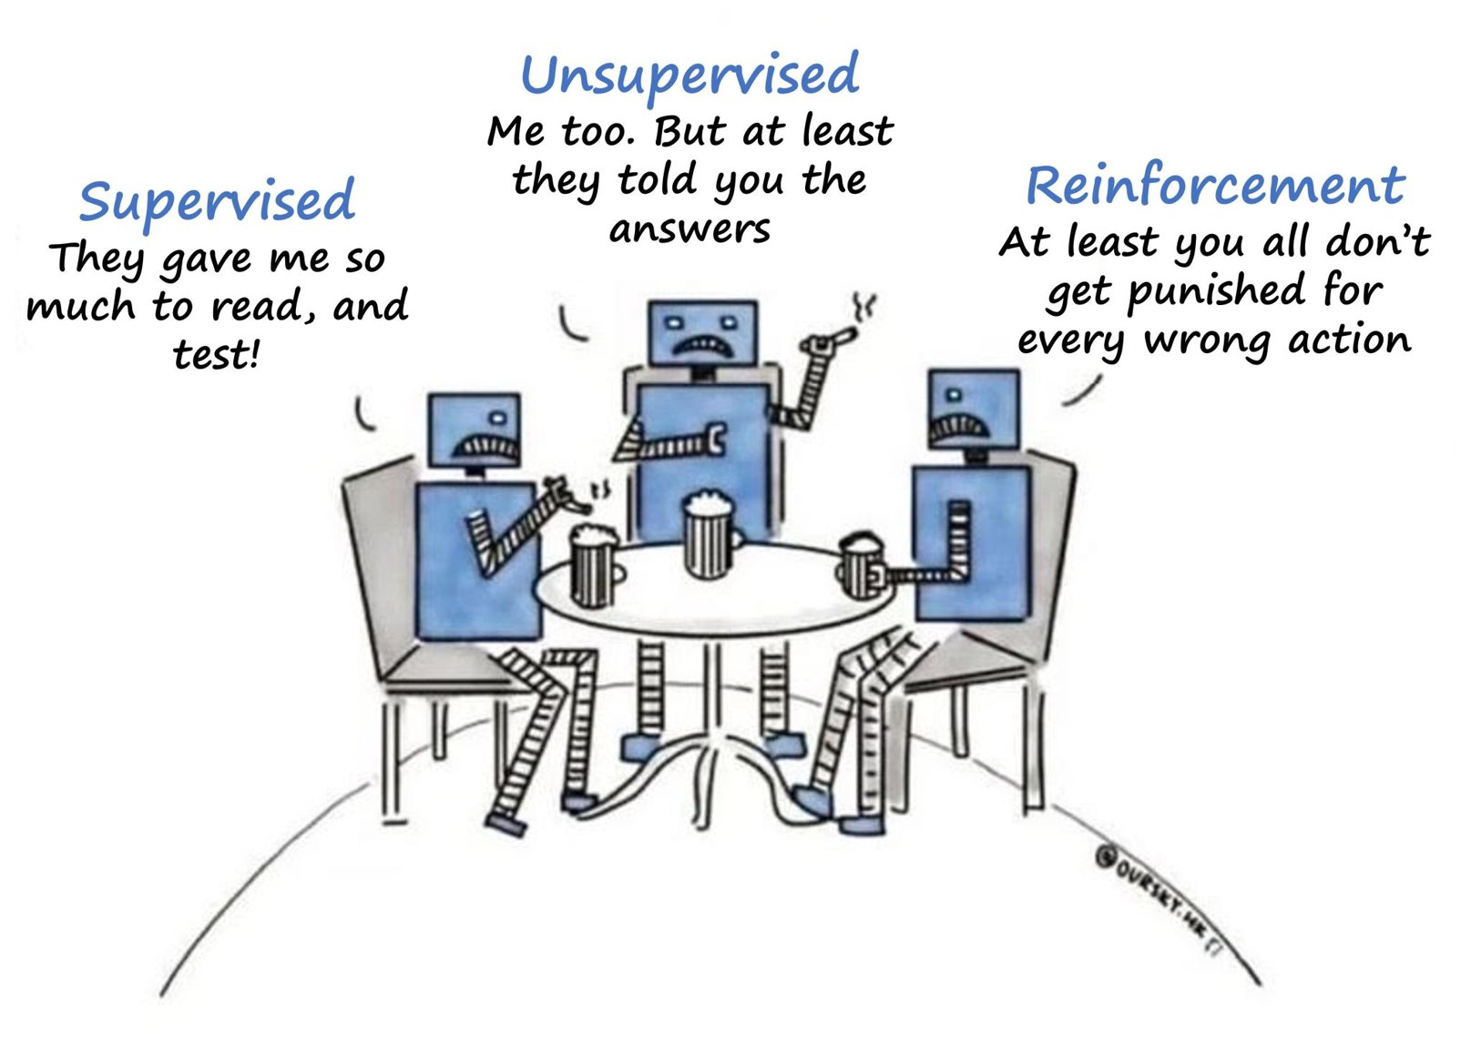

Slide 9
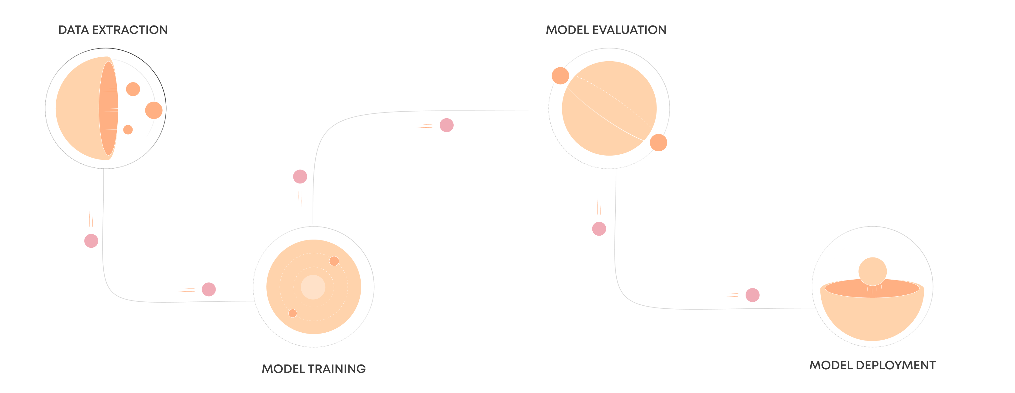
ML OPs
Image src: https://valohai.com/machine-learning-pipeline/

Slide 10
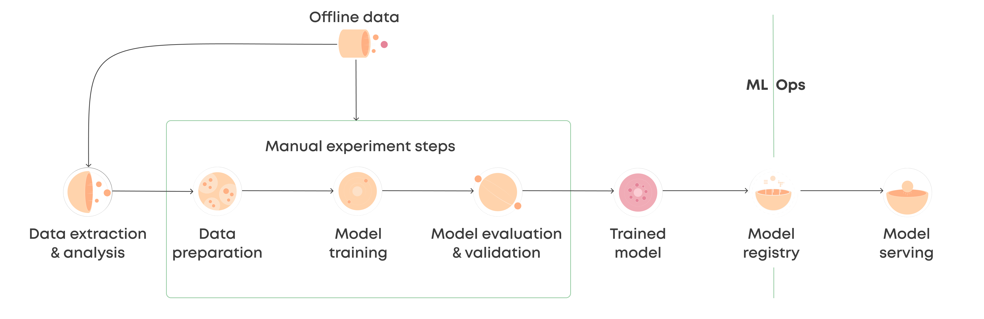
ML Ops - The Manual Cycle
Image src: https://valohai.com/machine-learning-pipeline/

Slide 11
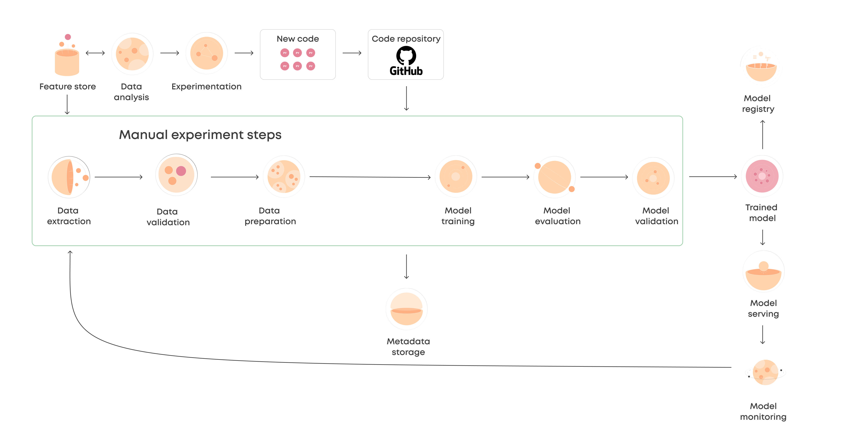
ML Ops - The Automated Pipeline
Image src: https://valohai.com/machine-learning-pipeline/

Slide 12
ML01:2023 Input Manipulation Attack
Defended By
Adversarial training.
Robust models.
Input validation.

Slide 13



Case of Autonomous Vehicle
hacktheml.web.app
STREET SIGN PERTUBRATIONS 120KMPH

Slide 14
ML02:2023 Data Poisoning Attack
Defended By
Data validation and verification.
Secure data storage.
Data separation.
Access control.
Monitoring and auditing.
Model validation.
Model ensembles.
Anomaly detection.

Slide 15
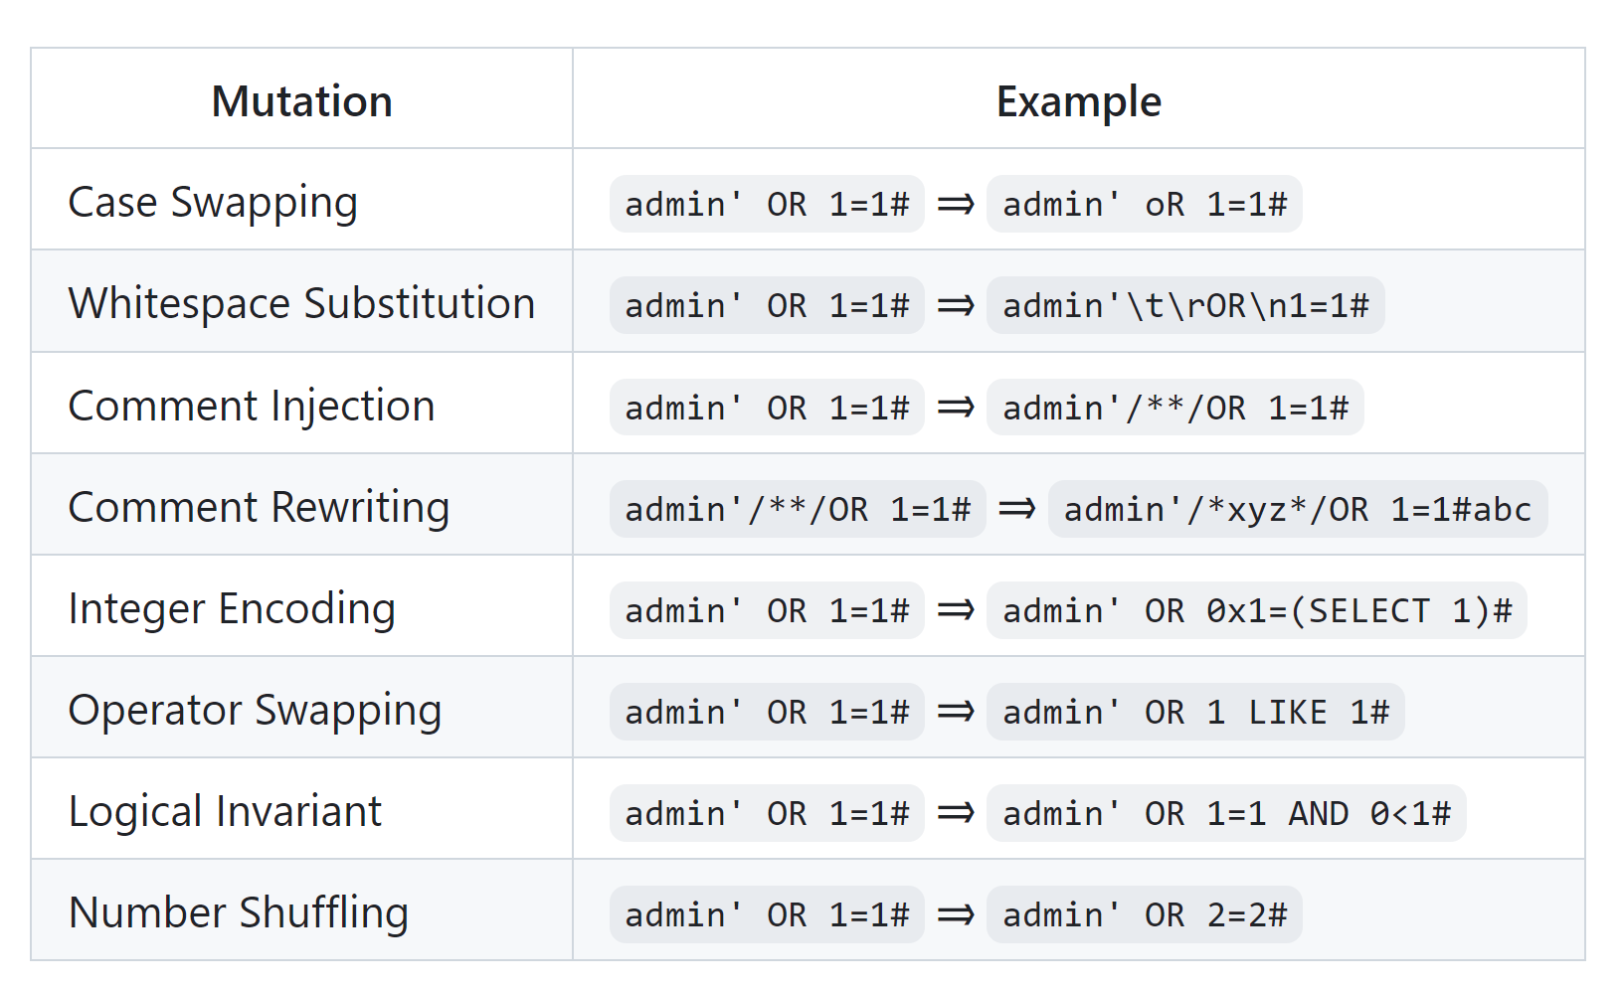
Case of waf

Slide 16
ML03:2023 Model Inversion Attack
Defended By
Access control.
Input validation.
Model transparency.
Regular monitoring.
Model retraining.

Slide 17

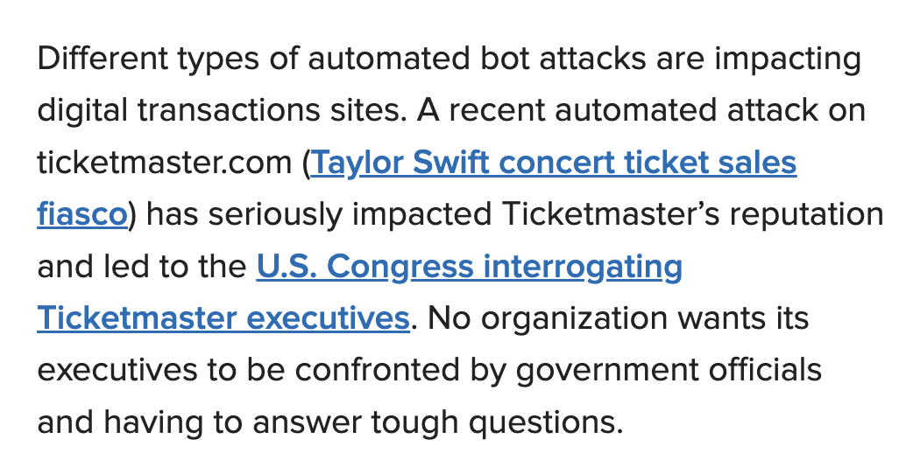
Case of Bot Detection
https://www.f5.com/company/blog/mitigate-attacks-cloudflare-apps-distributed-cloud-bot-defense

Slide 18
ML04:2023 Membership Inference Attack
Defended By
Model training on randomized or shuffled data.
Model Obfuscation.
Regularisation.
Reducing the training data.
Testing and monitoring.

Slide 19

Case of Banking

Slide 20
ML05:2023 Model Stealing
Defended By
Encryption.
Access Control.
Regular backups.
Model Obfuscation.
Watermarking.
Legal protection.
Monitoring and auditing.

Slide 21
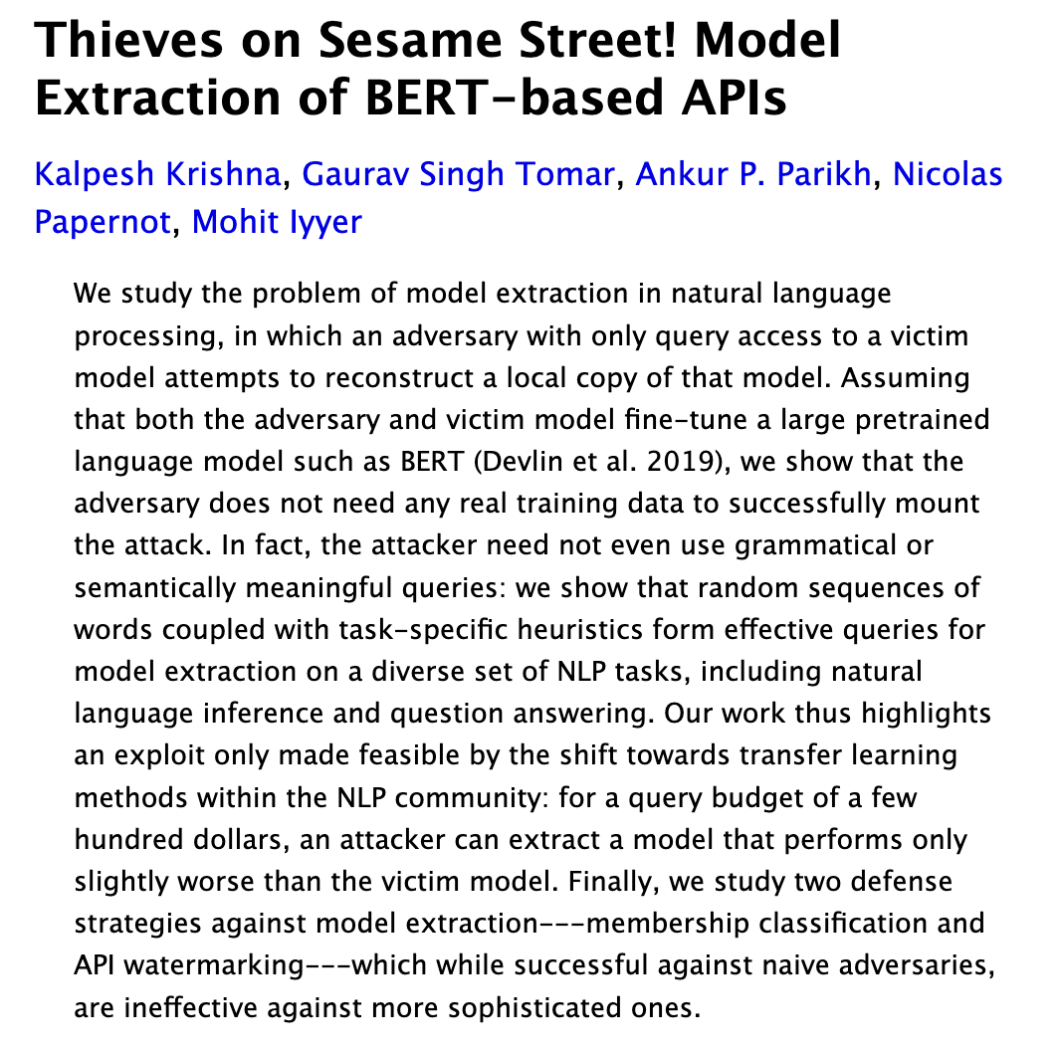
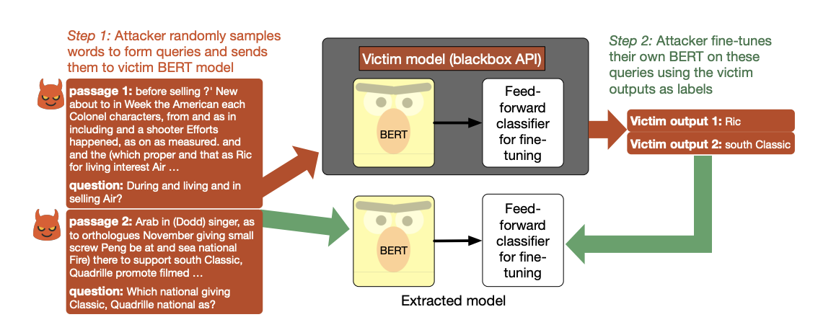
Case of Cloning ML Model

Slide 22
ML06:2023 AI Supply Chain Attacks
Defended By
Verify Package Signatures.
Use Secure Package Repositories.
Keep Packages Up-to-date.
Use Virtual Environments.
Perform Code Reviews.
Use Package Verification Tools.
Educate Developers.

Slide 23
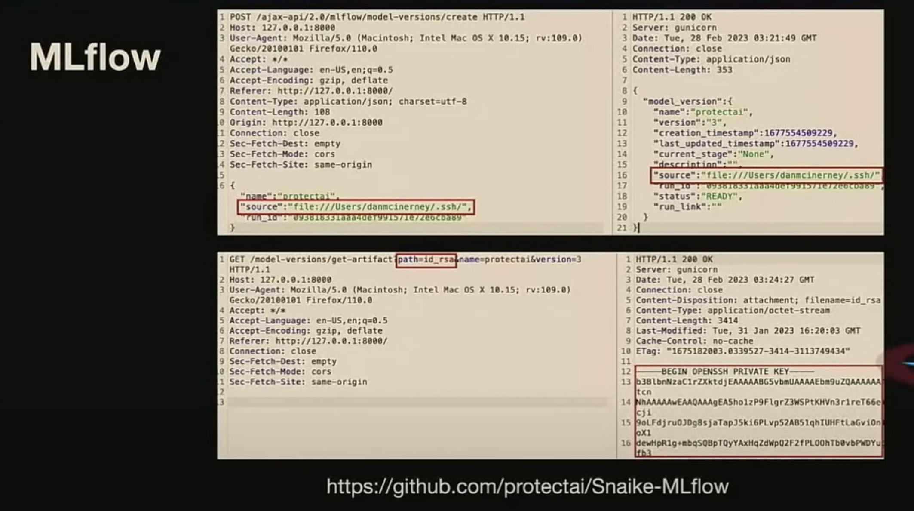
Case of Trojans

Slide 24
ML07:2023 Transfer Learning Attack
Defended By
Regularly monitor and update the training datasets.
Use secure and trusted training datasets.
Implement model isolation.
Use differential privacy.
Perform regular security audits.

Slide 25
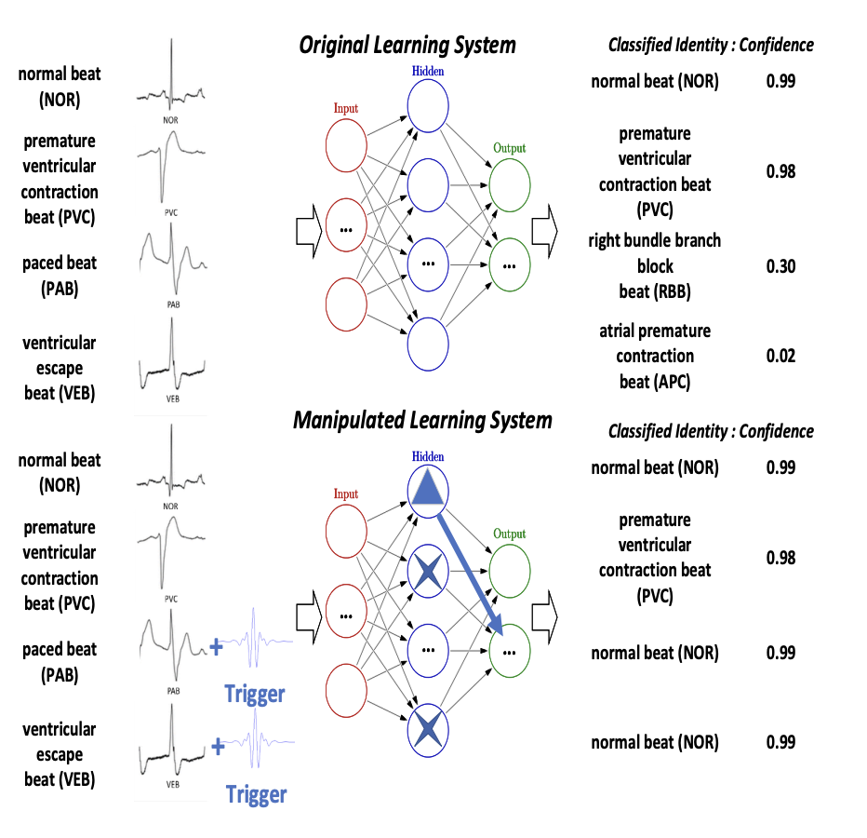
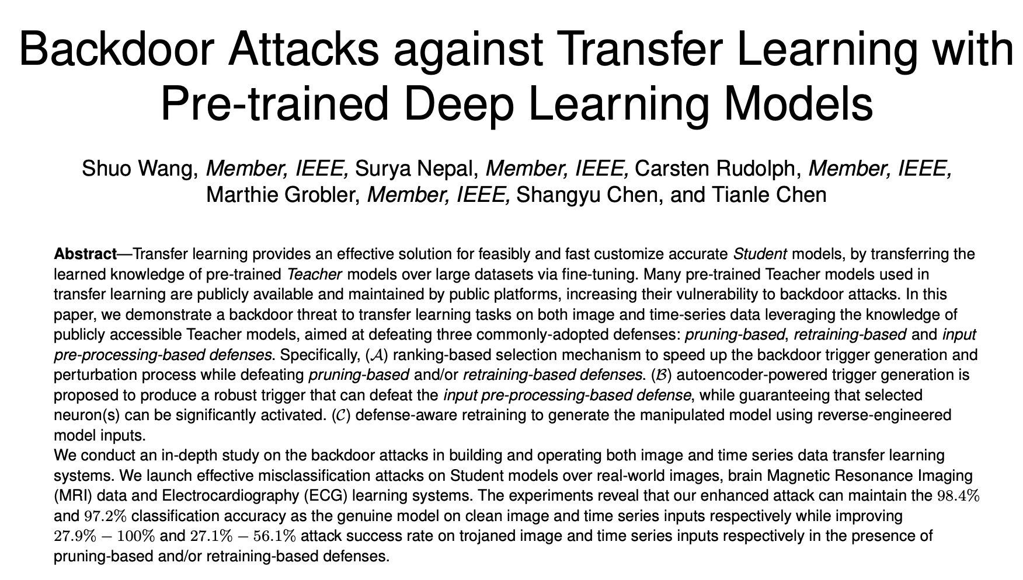
Case of Backdoor

Slide 26
ML08:2023 Model Skewing
Defended By
Implement robust access controls.
Verify the authenticity of feedback data.
Use data validation and cleaning techniques.
Implement anomaly detection.
Regularly monitor the model’s performance.
Continuously train the model.

Slide 27
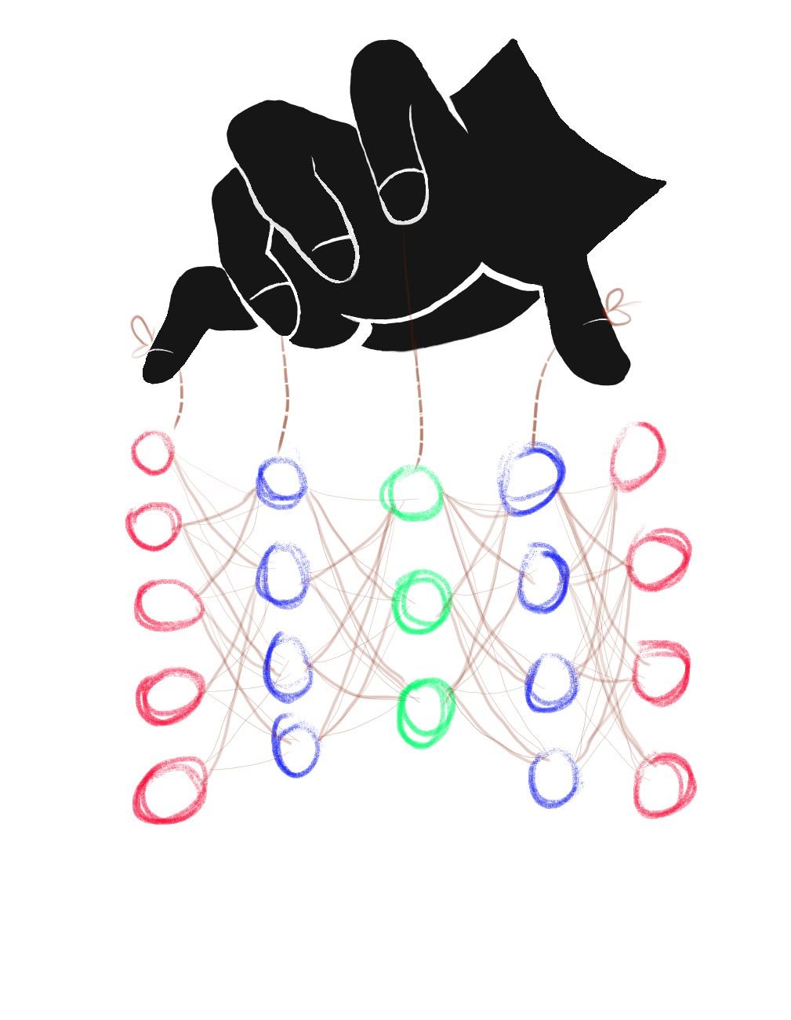
Case of Feedback

Slide 28
ML09:2023 Output Integrity Attack
Defended By
Using cryptographic methods.
Secure communication channels.
Input Validation.
Tamper-evident logs.
Regular software updates.
Monitoring and auditing.

Slide 29
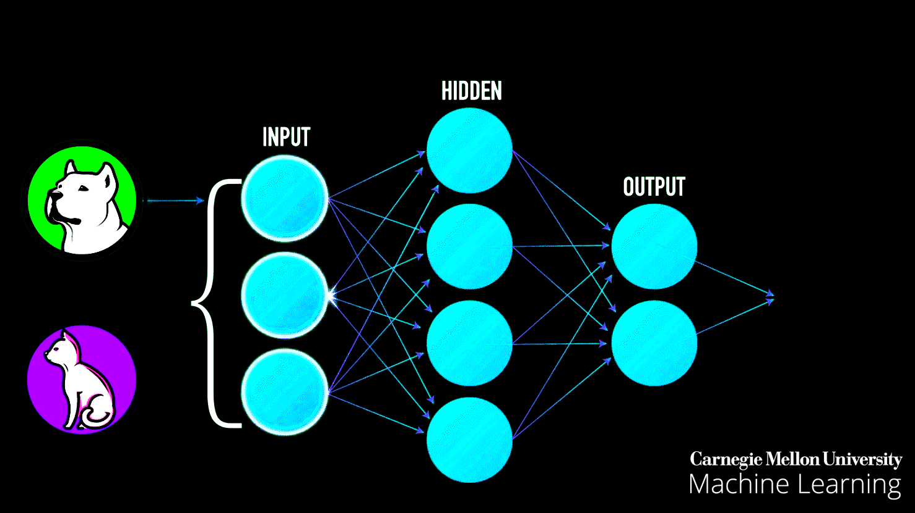
Case of Classifiers
Classifier for benign or tumorous cancer. Output integrity matters more.

Slide 30
ML10:2023 Model Poisoning
Defended By
Regularisation.
Robust Model Design.
Cryptographic Techniques.

Slide 31
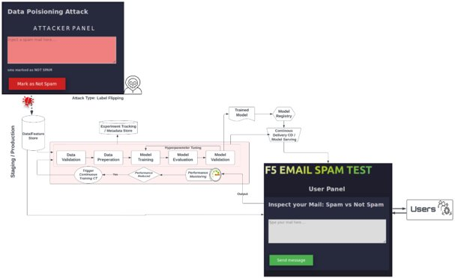
Case of Spams

Slide 32
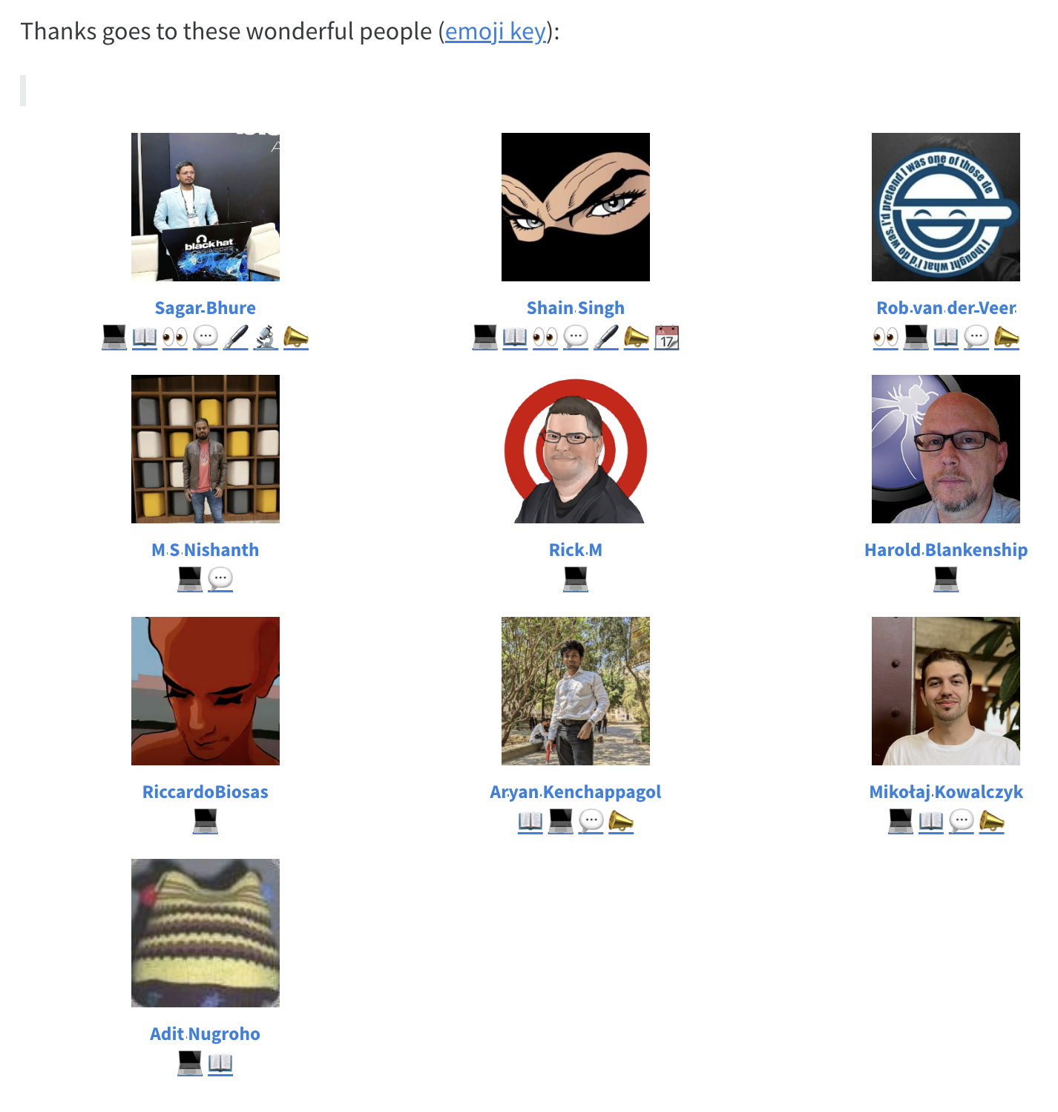
Contributors
We would love to see your name here!

